Slide 1

Anomaly Detection in Bank Transactions
Fraud Detection with Isolation Forest
Widya Catur Utami Putri
Data Portfolio
Complete Code at:
github.com/widyacatur/personalproject

Slide 2

Project Overview
Widya Catur Utami Putri - Data Portfolio
Data Preparation: Loading & Feature Engineering
This section focuses on getting the raw bank transaction data into a usable format This step ensures the data is clean, well-structured, and rich enough for effective analysis and modeling.
Exploratory Data Analysis (EDA): Patterns & Insights
Understand the data’s inherent characteristics through visualizations and summary statistics. The goal is to uncover typical spending behaviors, customer demographics, and channel usage patterns.
Anomaly Detection: Methodology & Outlier Characteristics
Using machine learning technique (Isolation Forest Model) to pinpoint unusual transactions. Crucially, we'll then analyze the specific traits of the detected outliers.
Recommendations & Next Steps
Translate analytical findings into actionable strategies. This includes concrete recommendations based on the outlier characteristics.

Slide 3
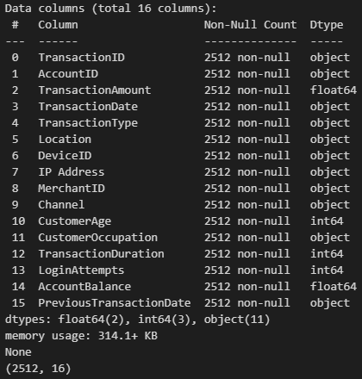

Data Loading & Initial Inspection
Dataset: Kaggle Bank Transaction Dataset for Fraud Detection.
Initial Inspection:
We have 2,512 transactions and 16 columns.
The Transaction Date and Previous Transaction Date columns were not in the correct datetime format, which will be corrected in the next step.
Next Steps: Clean and prepare the data for analysis.
Widya Catur Utami Putri - Data Portfolio

Slide 4

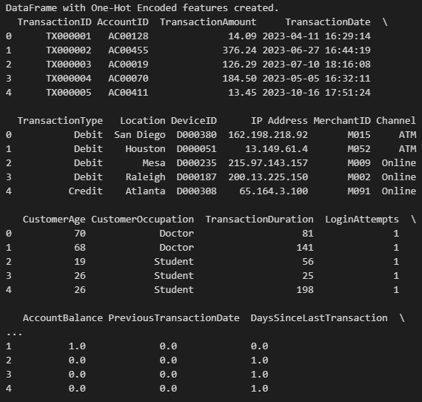
Feature Engineering
Widya Catur Utami Putri - Data Portfolio
Date/Time Features:
Converted date columns to the proper datetime format.
Extracted the TransactionHour and TransactionDay of the week.
Calculated DaysSinceLastTransaction to identify unusual gaps between transactions.
Encoding:
Used Label Encoding for ordinal data like TransactionDay and CustomerOccupation.
Used One-Hot Encoding for nominal data like TransactionType and Channel.
New Ratios & Brackets:
Created BalanceChangeRatio by dividing the TransactionAmount by the AccountBalance.
Categorized CustomerAge into AgeBracket groups.

Slide 5
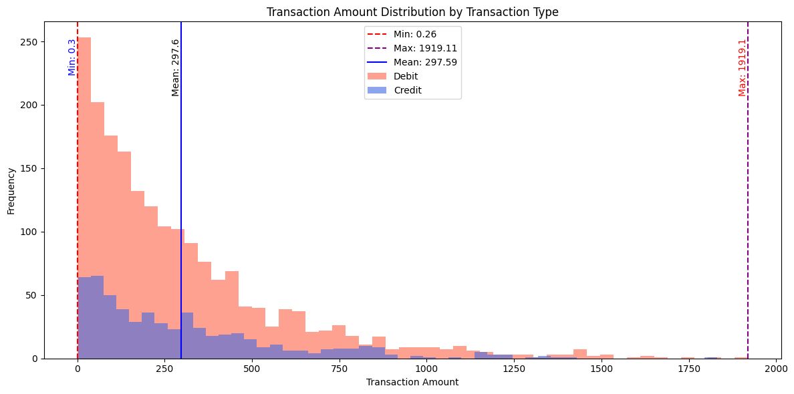
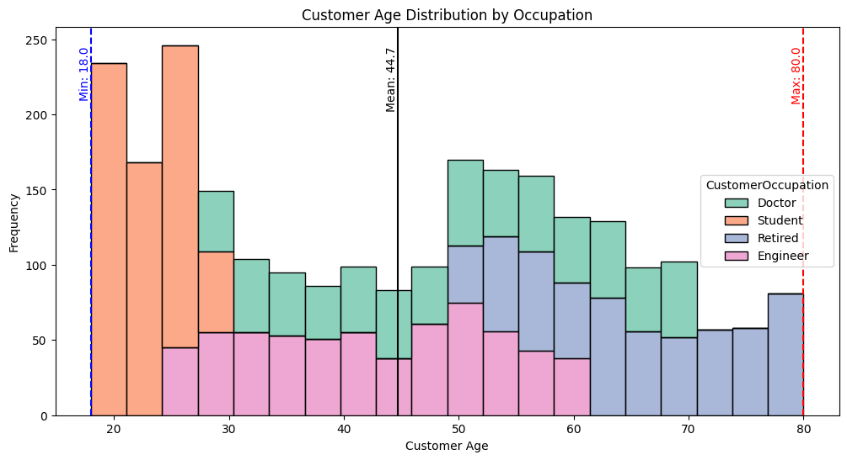

Key Findings from EDA
Transaction Amount: On average, customers spend around $298 per transaction. The amounts range from as low as $0.30 to a high of $1,919.
Transaction Types: Debit transactions are more frequent and generally have higher values than credit transactions.
Customer Ages: Range from 18 to 80 years old, with an average age of 44.
Customer Occupation: Dominated by Students with 657 transactions, followed closely by Doctors and Engineers with 631 and 625 transactions, respectively.
Widya Catur Utami Putri - Data Portfolio

Slide 6

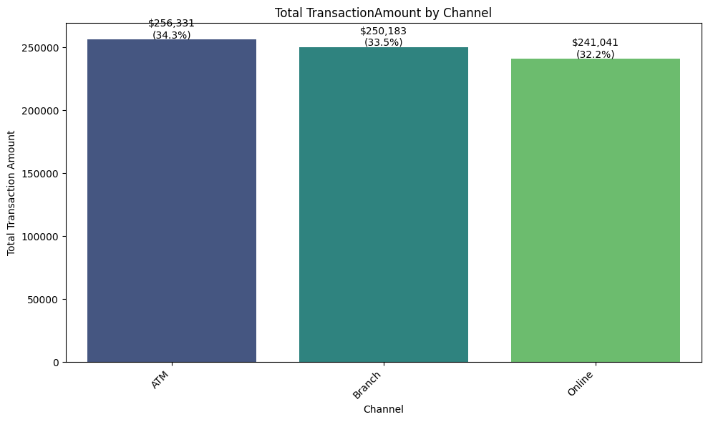
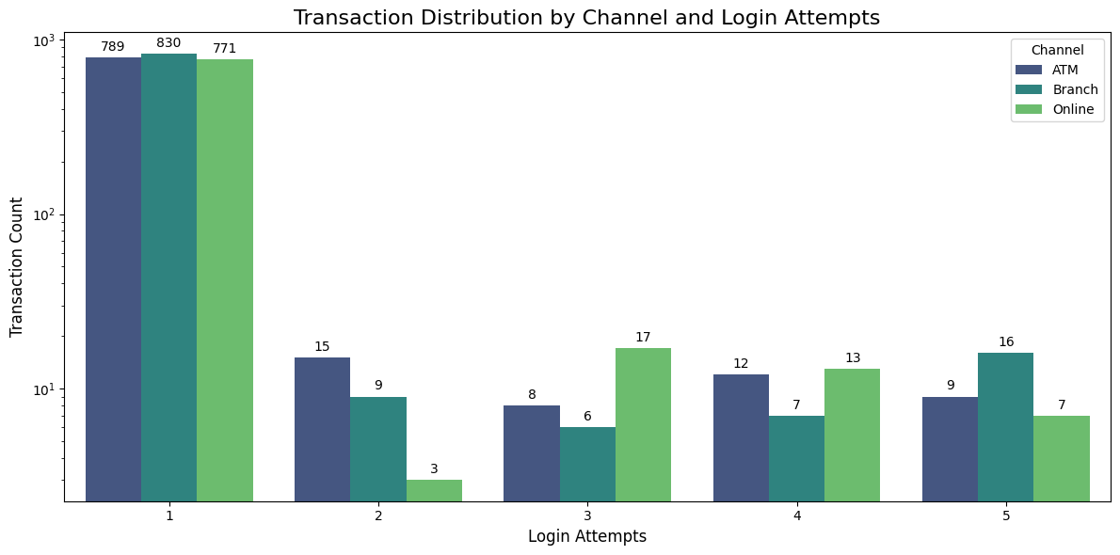
Key Findings from EDA
Most customers successfully logged in on their first try. However, a small but notable number of transactions, specifically 32 out of 2,512, required five login attempts, representing approximately 1.3% of the total transactions. A deeper look showed that the Branch channel was the most frequently used channel among these multiple-attempt transactions.
Widya Catur Utami Putri - Data Portfolio

Slide 7
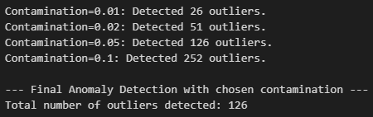
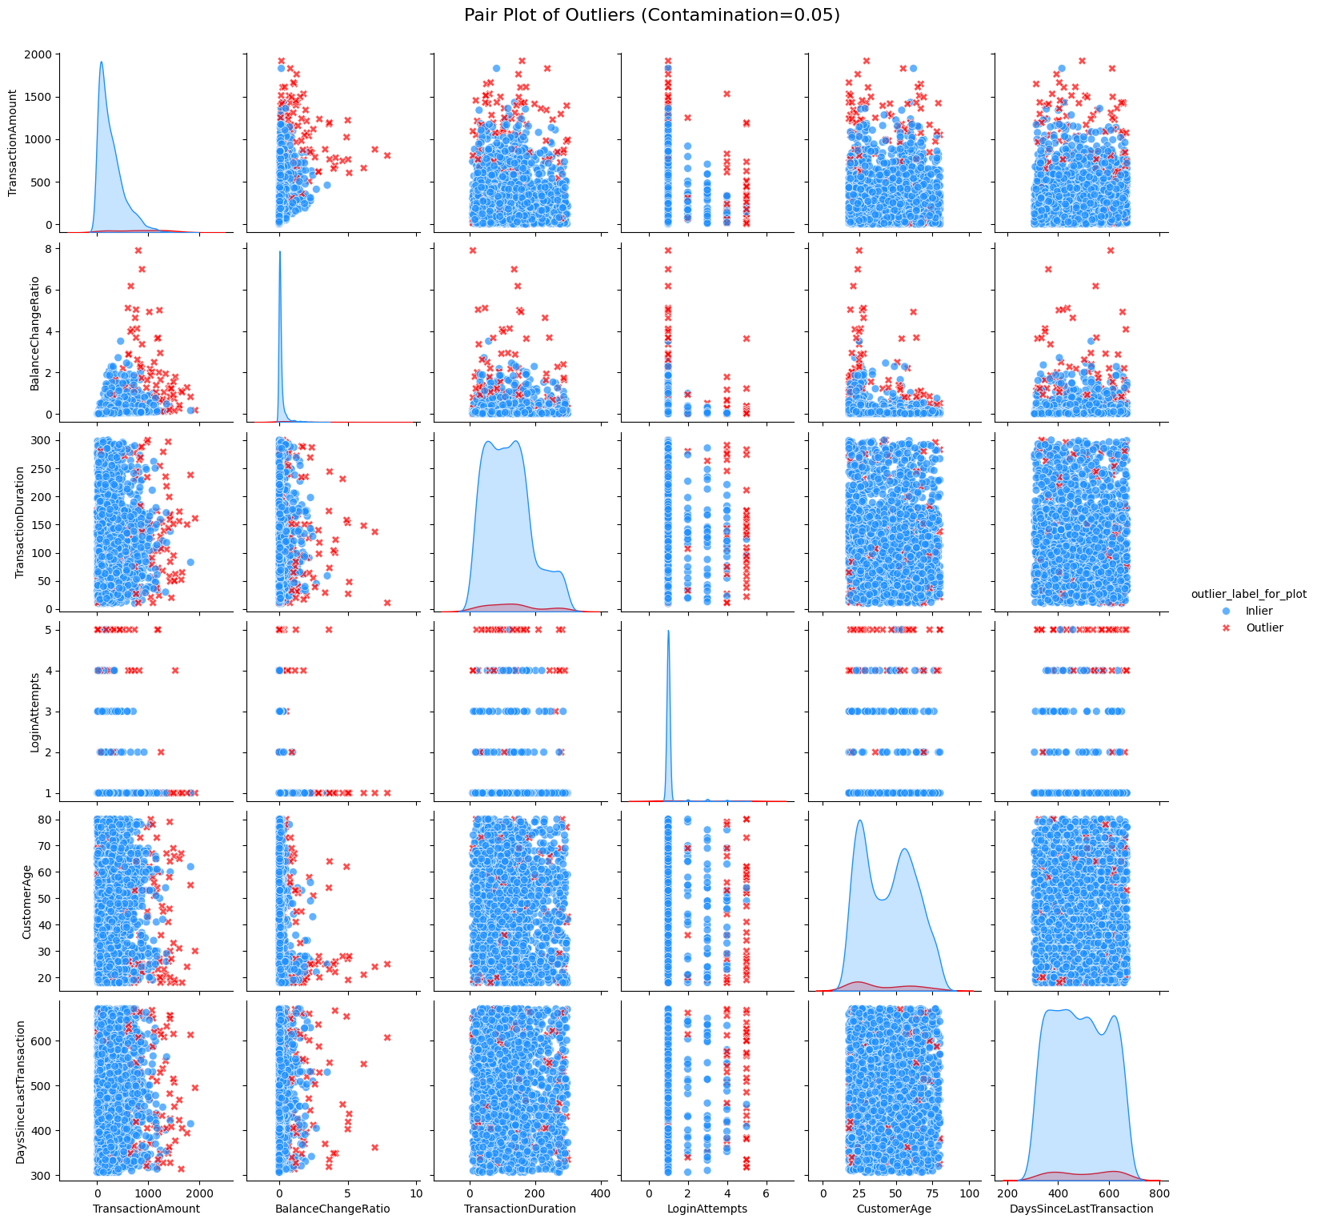

Anomaly Detection: Methodology
The Isolation Forest model is used to detect unusual transactions by breaking the data into smaller segments, making it easier to isolate entries that differ from the norm.
It includes a parameter called contamination, which defines the expected proportion of outliers. After testing several values, a contamination level of 5% was chosen, resulting in 126 transactions being flagged as potentially suspicious.
Widya Catur Utami Putri - Data Portfolio

Slide 8
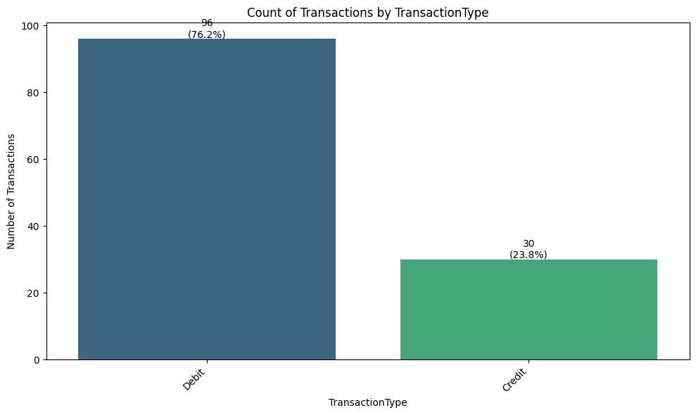

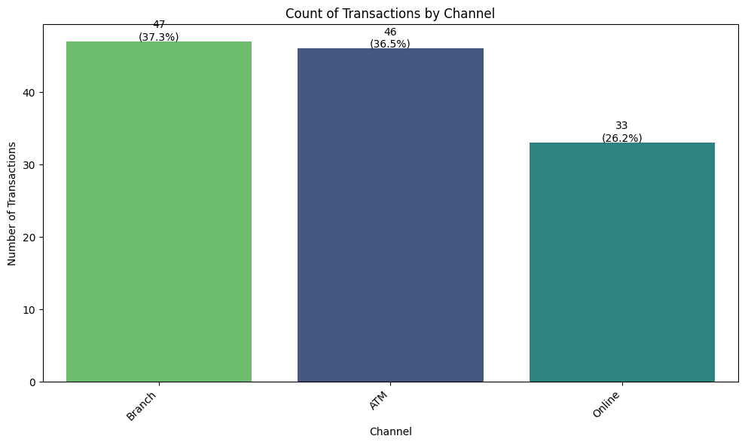
Anomaly Detection: Outlier Characteristics
Transaction Type:
76.2% Debit vs. 23.8% Credit.
Debit transactions are disproportionately represented among outliers, aligning with their higher frequency and value in the overall dataset.
Channel:
37.3% Branch, 36.5% ATM, 26.2% Online.
In-person channels (Branch, ATM) show a higher concentration of anomalies, suggesting potential vulnerabilities or unique patterns.
Widya Catur Utami Putri - Data Portfolio

Slide 9
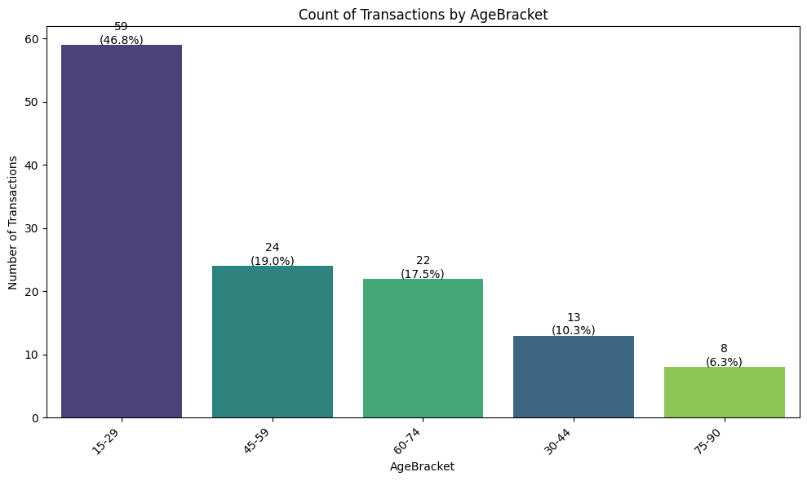

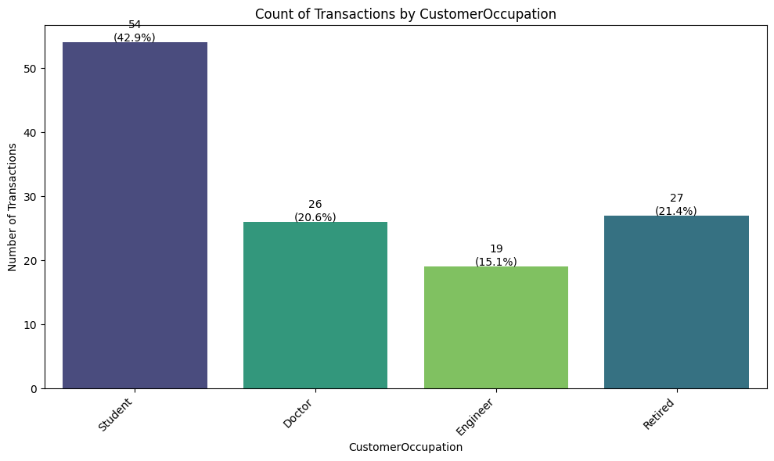
Anomaly Detection: Outlier Characteristics
Age Bracket:
46.8% from 15-29 age group.
Younger customers (and students) are significantly overrepresented in the outlier group.
Customer Occupation:
42.9% Students, 21.4% Retired, 20.6% Doctors.
Consistent with age bracket findings, students’ transactions are frequently flagged as unusual.
Widya Catur Utami Putri - Data Portfolio

Slide 10

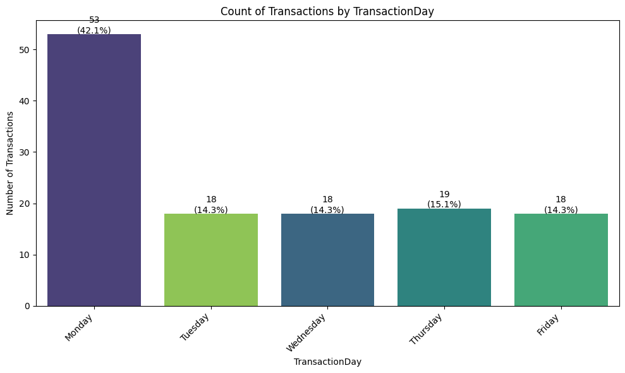
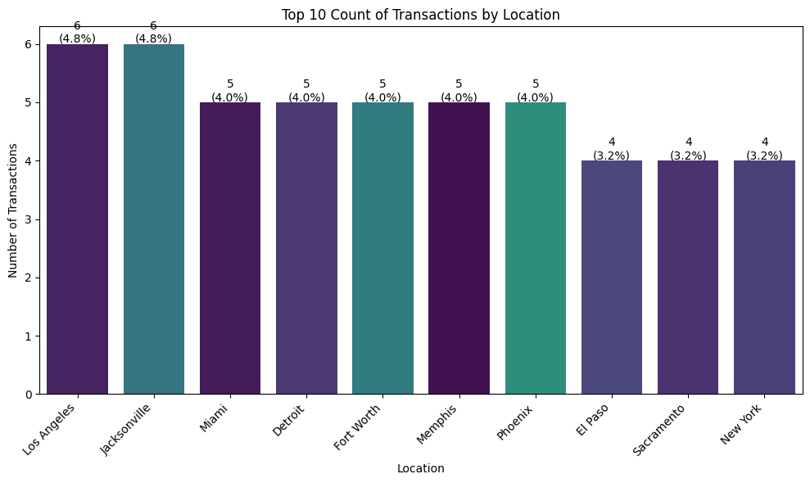
Anomaly Detection: Outlier Characteristics
Transaction Day:
42.1% occurred on Monday.
A strong temporal pattern, with a high spike in anomalies at the start of the week.
Location:
Outliers are widely distributed, with Jacksonville and Los Angeles having slightly higher counts.
Anomalies are not confined to a specific geographical area.
Widya Catur Utami Putri - Data Portfolio

Slide 11

Recommendations & Next Steps
Based on the analysis, here are actionable recommendations to secure transaction processes:
Prioritize Debit Transaction Monitoring: Implement stricter real-time monitoring and anomaly detection rules specifically for debit transactions, given their high outlier rate.
Strengthen ATM & Branch Security Protocols: Review and enhance security measures for in-person transactions, particularly at ATMs and branches, considering their higher susceptibility to unusual activity and multiple login attempts.
Implement Targeted Scrutiny for Younger Demographics: Develop specific alert thresholds or review processes for transactions originating from the 15-29 age bracket and Students, as their transactions are frequently flagged as unusual.
Investigate Monday Activity Spikes: Conduct deeper forensic analysis into transactions occurring on Mondays to understand the root causes of the elevated anomaly rate on this specific day.
Develop a Tiered Alert System: Create an automated system that generates different alert levels based on a combination of high-risk factors (e.g., a high-value debit transaction from an ATM by a young student on a Monday).
Widya Catur Utami Putri - Data Portfolio

Slide 12
Thank you
Widya Catur Utami Putri
Data Portfolio
Complete Code at:
github.com/widyacatur/personalproject

